Slide 1
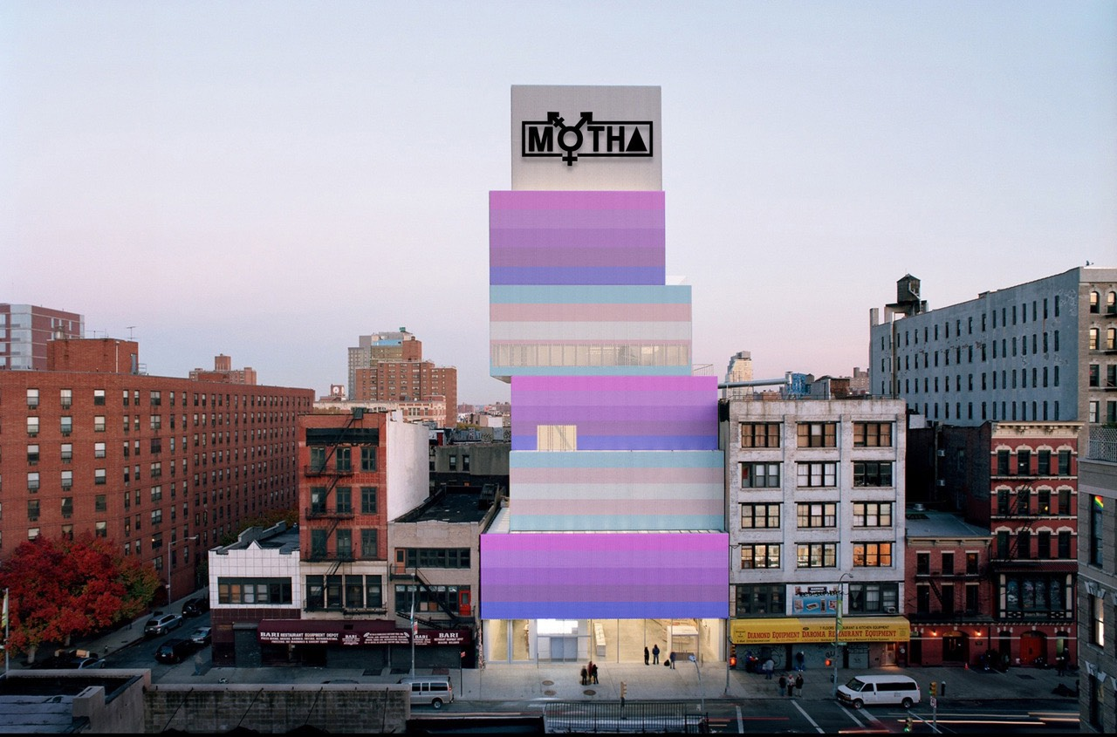
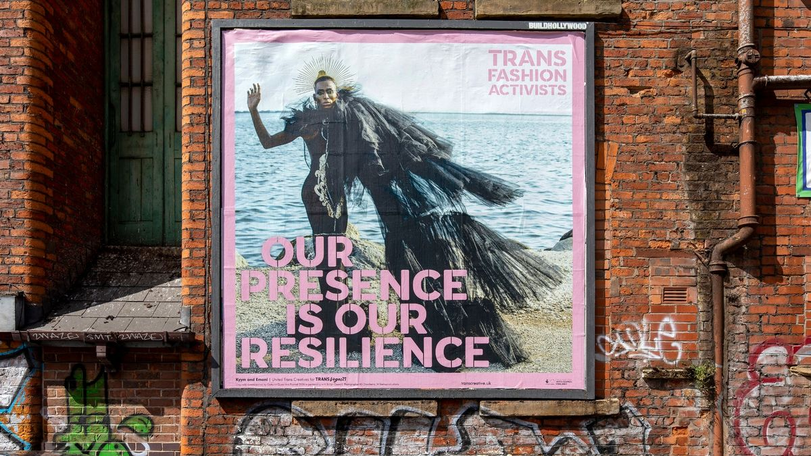
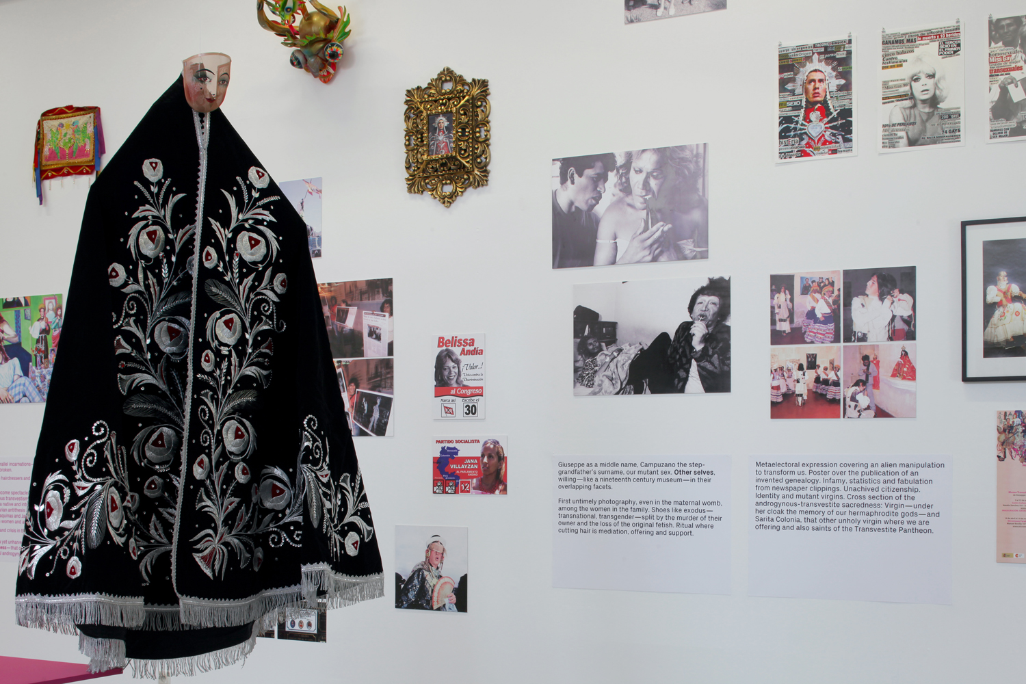
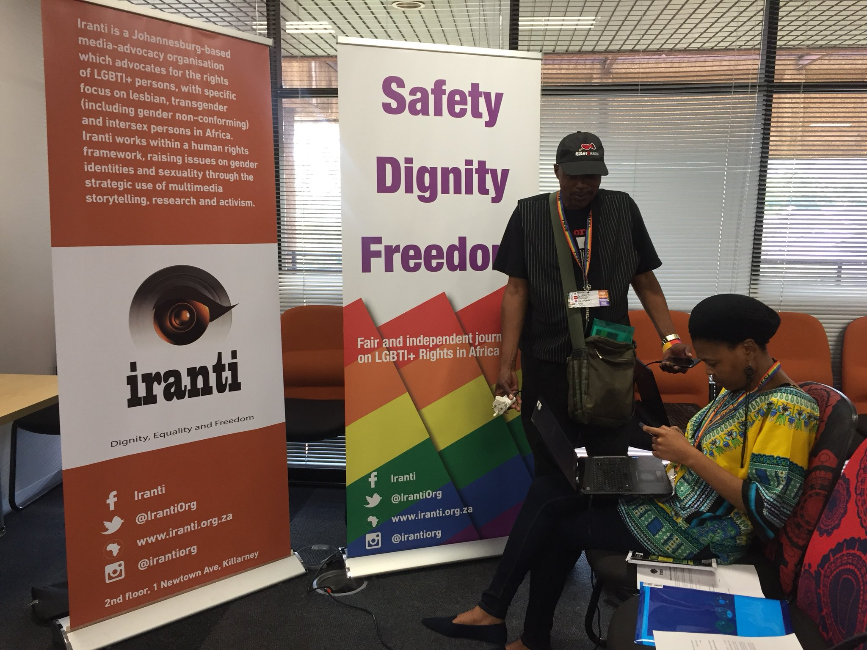
Sheroes Activist Art Forum: Queer Activist Histories of Art
Cas Bradbeer, they/them, lgbtq@courtauld.ac.uk

Slide 2
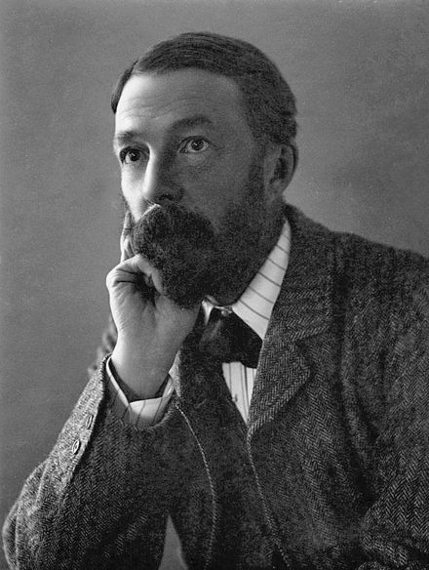
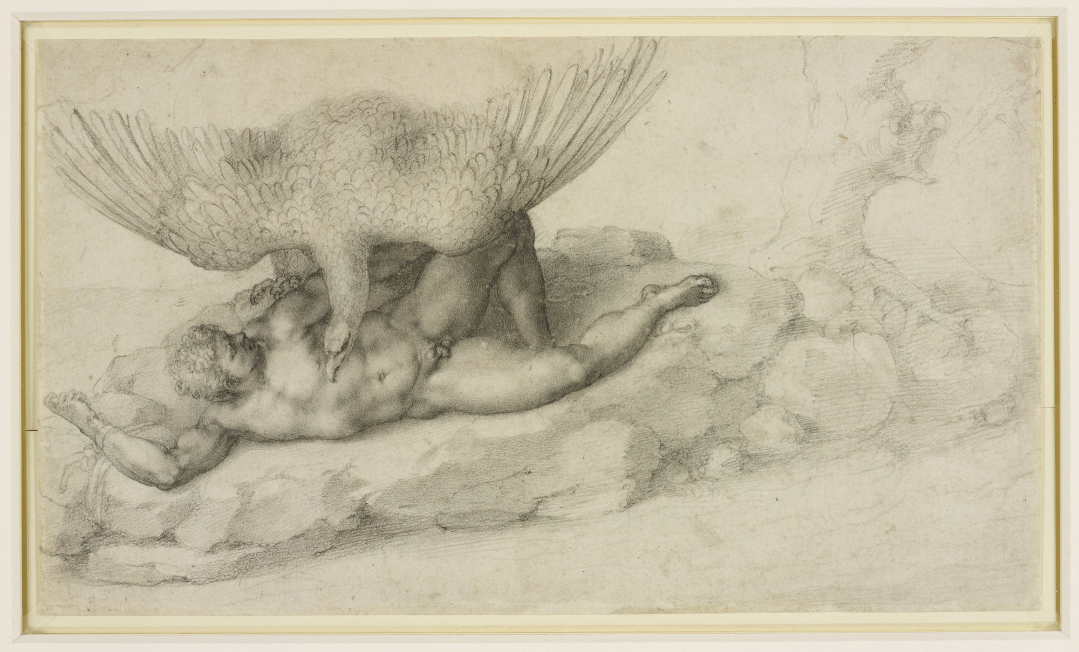
John Addington Symonds and Michelangelo
If one chaste love, if one God-given piety,
if one same fortune by two lovers dared,
if one the grief but two the pain it shared
- passage from a c.1532 poem addressed to Tommaso Cavalieri
If, to be happy, I must be conquered and chained,
it is no wonder that, naked and alone,
I remain prisoner of an armed cavalier.
- passage from a c.1534-8 poem addressed to Tommaso Cavalieri
Michelangelo Buonarroti
Tityus (1532)
Black Chalk, 19 x 33 cm
Royal Collection, Windsor

Slide 3
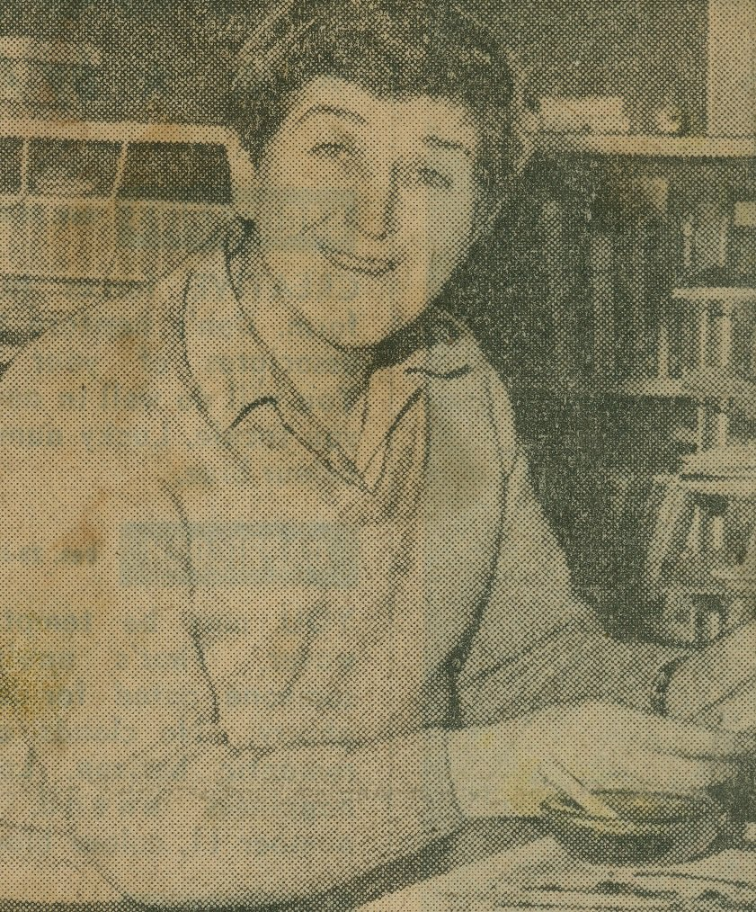
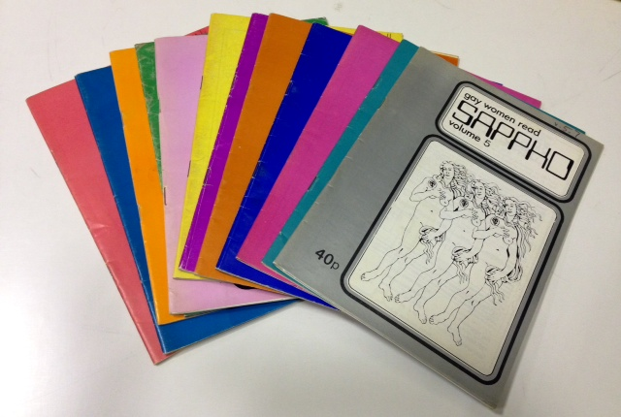
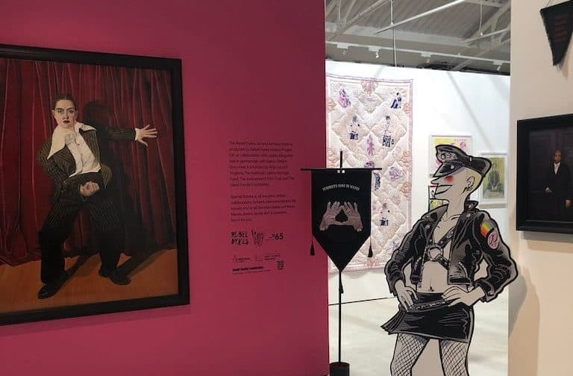
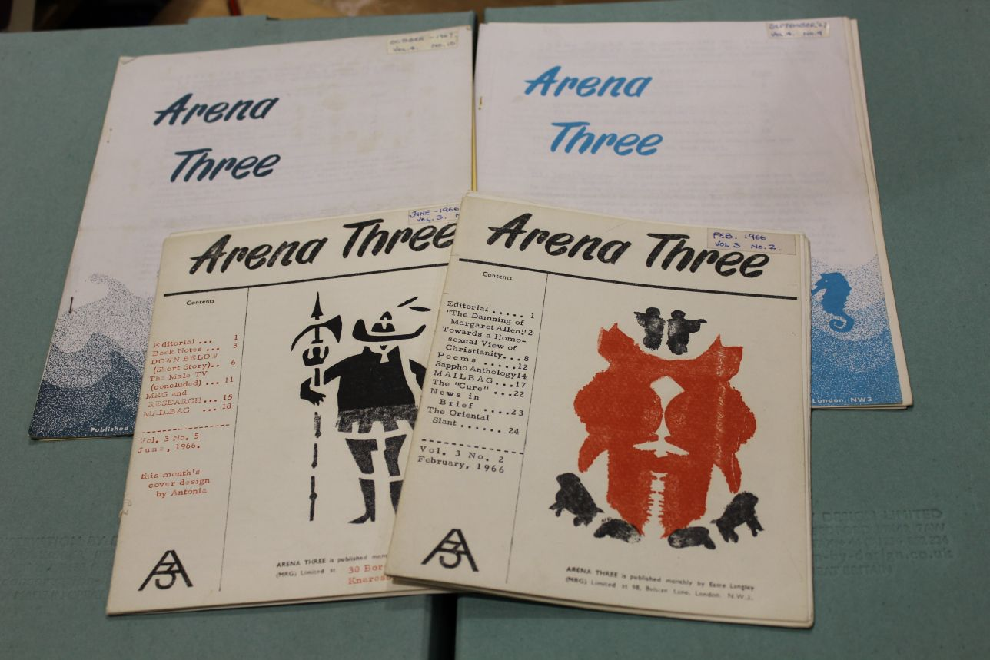
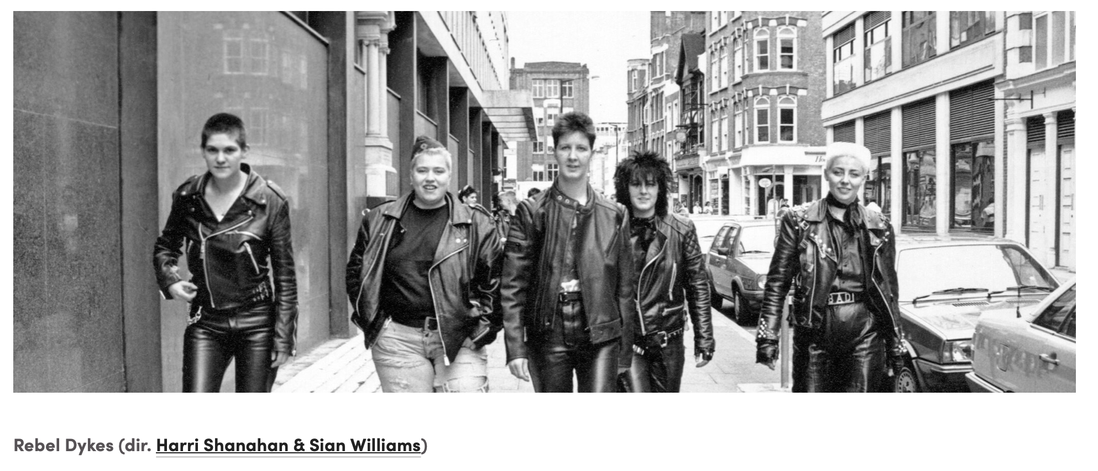
Minorities Research Group & Rebel Dykes
Esme Langley, founder of the Minorities Research Group
Sappho magazines in The British Library
Rebel Dykes 2021 exhibition (at Space Station Sixty-Five) and film (at BFI Flare)
Arena Three magazines in Glasgow Women’s Library

Slide 4
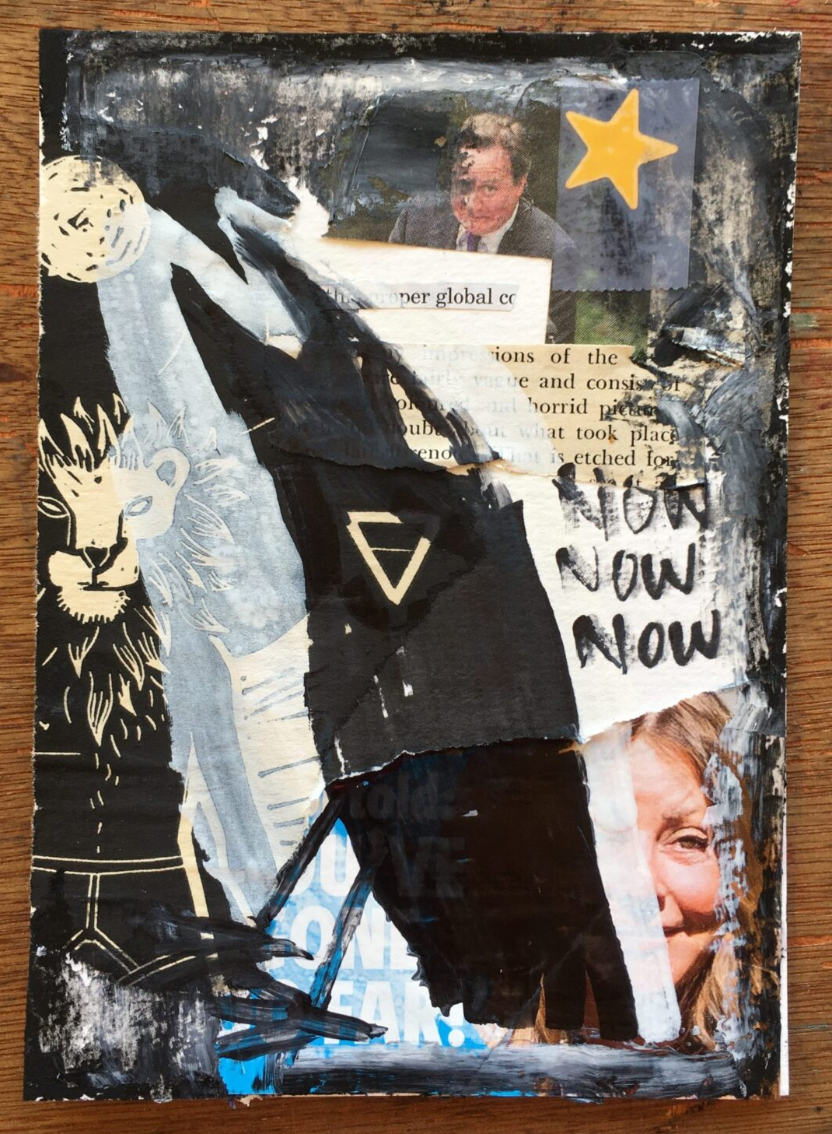
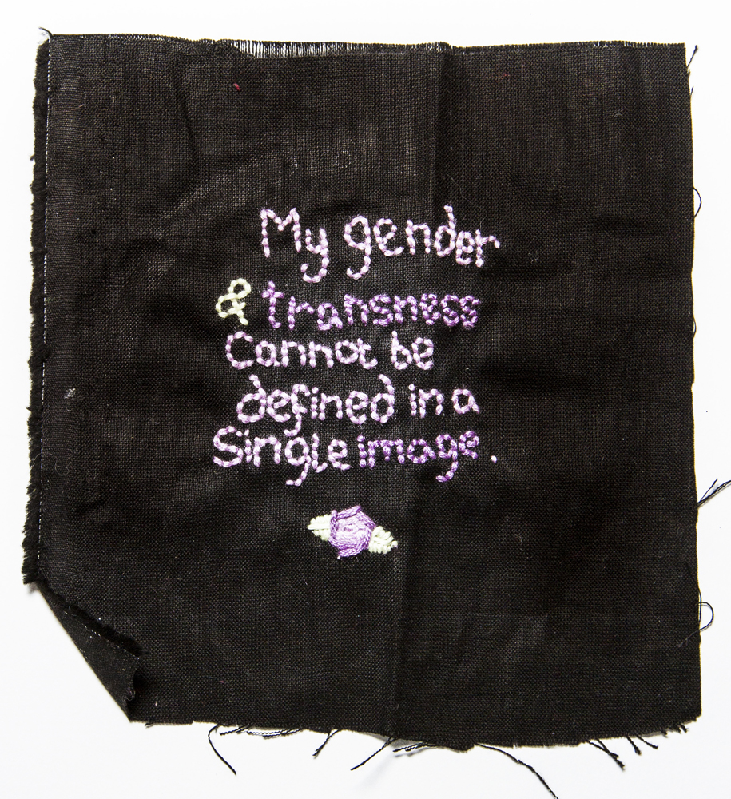
What Now?
Queercircle
Part of the Museum of Transology
Mx Frank Duffy’s £30 crow postcards for trans charities
Exist Loudly Fund

Slide 5
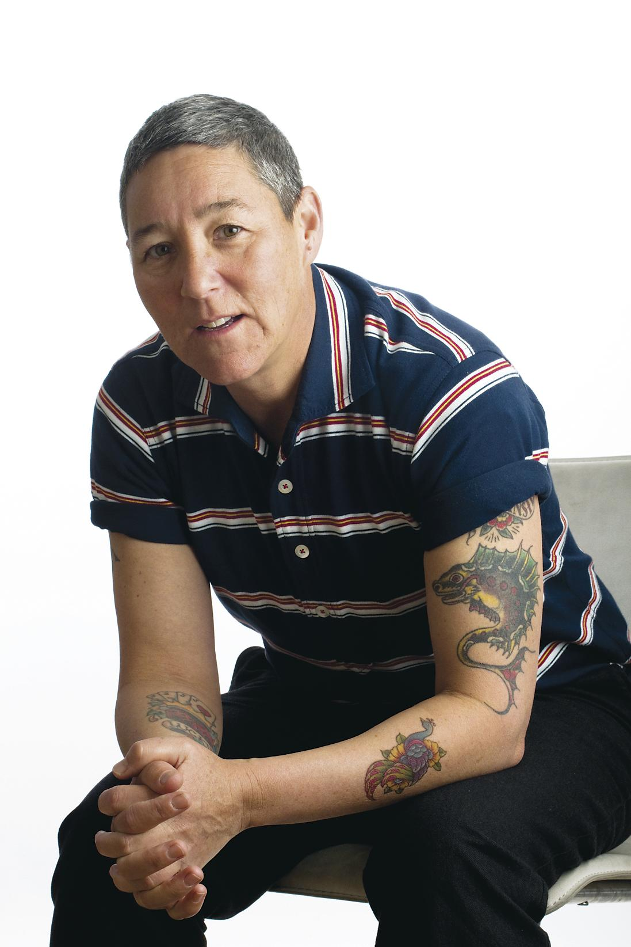
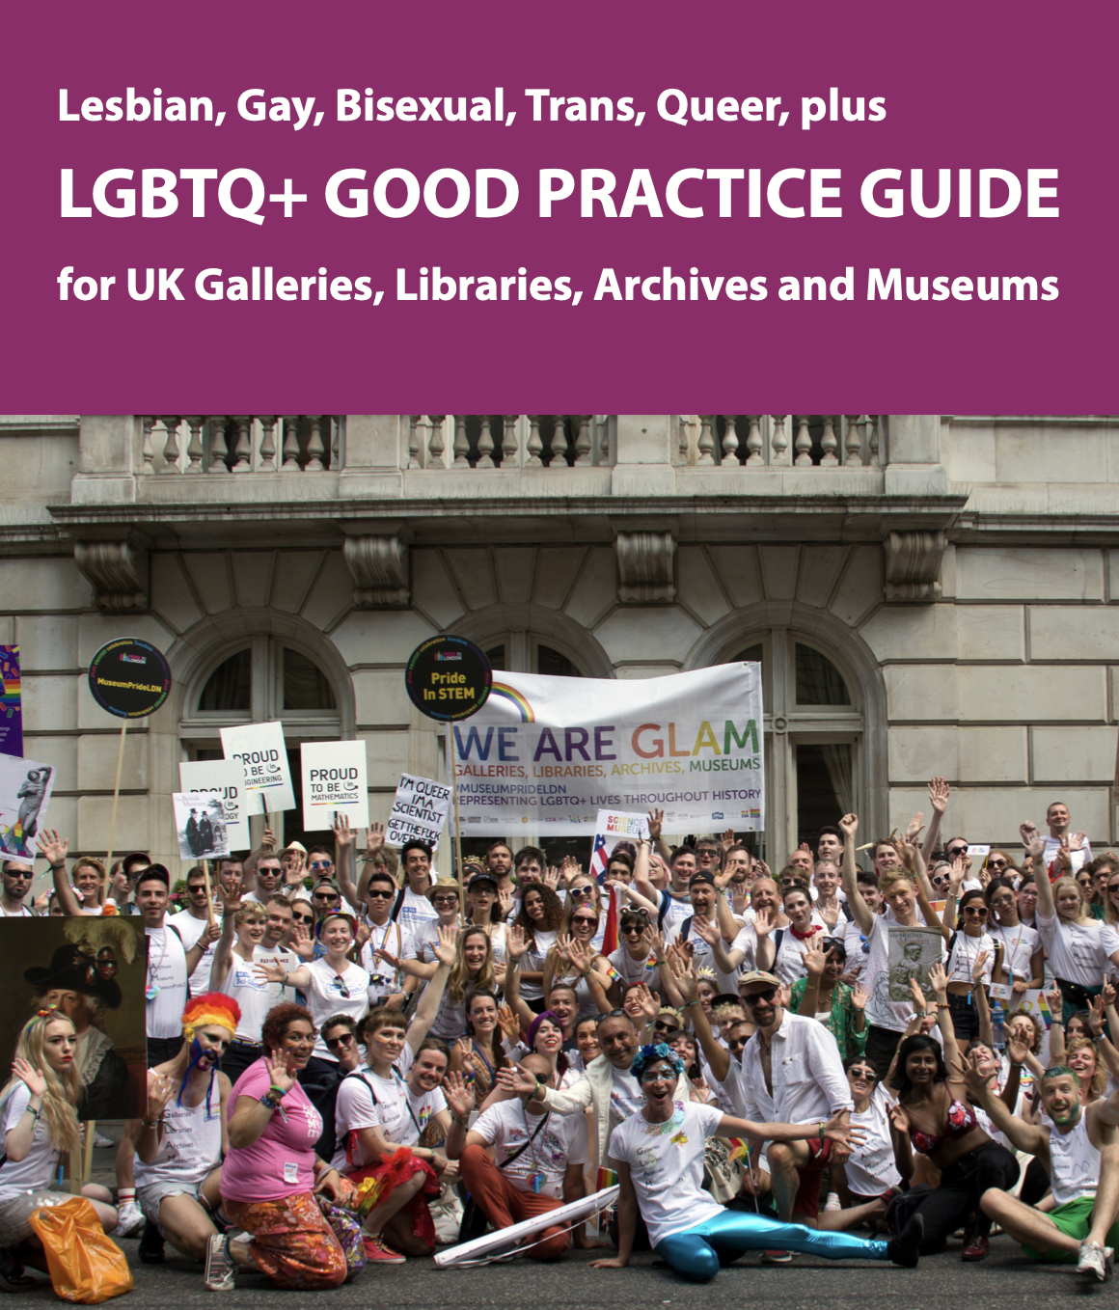
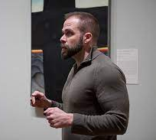
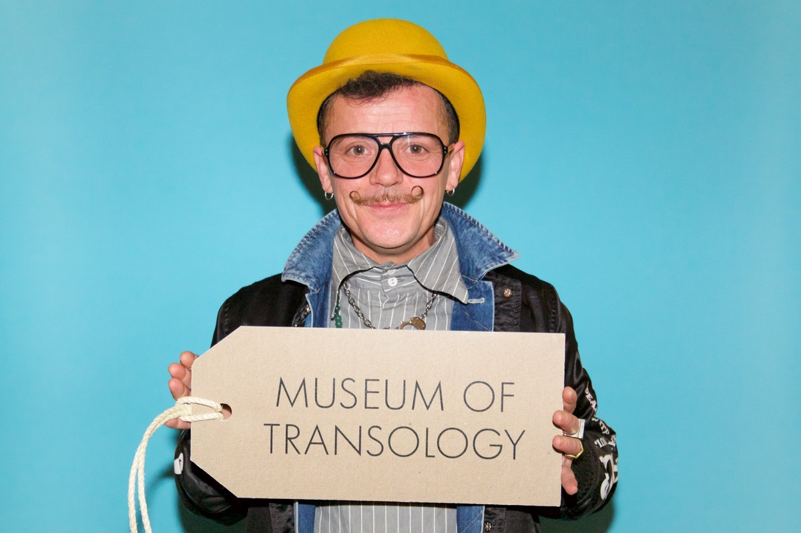
Sharing Curating Ideas
Jack Halberstam
Maura Reilly’s 2018 book Curatorial Activism
Arts Council Guide
David Getsy
E. J. Scott

Slide 6
Sheroes Activist Art Forum: Queer Activist Histories of Art
Cas Bradbeer, they/them, lgbtq@courtauld.ac.uk

